Slide 1
Culture and Creativity: The Sounds of Writing
Malu Sciamarelli
Braz-TESOL Intercultural Language Education SIG Pre-Conference Institute (PCI)
14th July 2016
Brasília, Brazil

Slide 2
Clarice Lispector’s Writing by Ear
The question is: how do I write? I can verify that I write by ear.
(The Hour of the Start)

Slide 3
Writing by Ear: a connection between written words and the sense of hearing.
Angela is the vibrating quake of a tense harp string that has been plucked: she remains in the air still, speaking to herself, speaking – until the vibration dies out, spreading in foam on the sands. Then – silence and stars. (A Breath of Life)
Macabea is dead. The bells were ringing without making any sound. I now understand this story. She is the imminence in those bells, pealing softly. (The Hour of the Star)
The words are sounds transfused with shadows that intersect unevenly, stalactites, woven lace, transposed organ music. I can scarcely invoke the words to describe this pattern, vibrant and rich, morbid and obscure, its counterpoint the deep bass of sorrow. Allegro con brio. (The Hour of the Star)

Slide 4
Clarice Lispector’s Writing by Ear for the Creative Writing Classroom
The ETAS (English Teachers Association, Switzerland) Journal, Volume 31, no. 2, pp. 40-41, 2014.
The Music of Words upon Words
iTDi Blog, Available at http://itdi.pro/blog/2014/04/18/the-creative-writing-issue-malu/

Slide 5
Listen to sounds and write
Feel the emotions provoked by sounds and write
Remember something when you listen to sounds and write
The Sounds of Writing:
Hear sounds and write words
Acoustic properties of writing, present at the moment of creation
The Joy of Phonetics and Accents, Louis Colaianni

Slide 6
Focus?
Technology can be good sometimes, but it contributes to distraction and encourages multitasking.
Multitasking is an illusion - the brain performs activities in series
Environment → Attention Deficit Trait:
Impairs critical and creative thinking
Lose perspective
Unable to pay attention and focus
(Dr Richard Chambers, Monash University)

Slide 7
Activity 1: The Sounds of Writing
1. Choose a book from the library.
2. Open on a random page.
3. Read the page and choose one sentence.
4. Write it down but do not show anyone.
5. Choose one word to start a sentence.
6. Write the word on 5 slips of paper
(different colours).

Slide 8
7. Listen to these songs and write a short sentence with what you feel when you listen to them:
a) Green – World of Stone, Blackmore’s Night
b) Red – You’re gonna break my heart again, Whitesnake
c) Orange – Ninth Symphony, Beethoven
d) White – Everything, Michael Buble
e) Blue – On Nemo Bhagavate, Deva Premal
8. Put all the strips together and face them down.
9. Get the students collect 5 strips back - any colours.

Slide 9
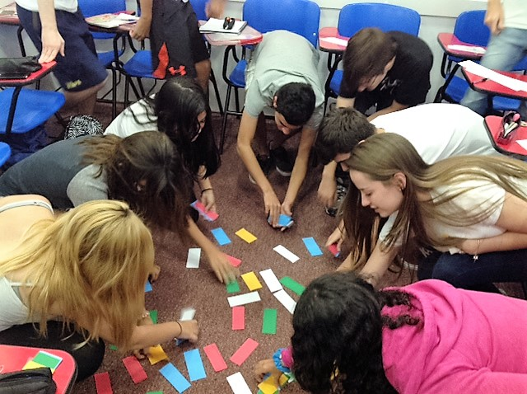

Slide 10
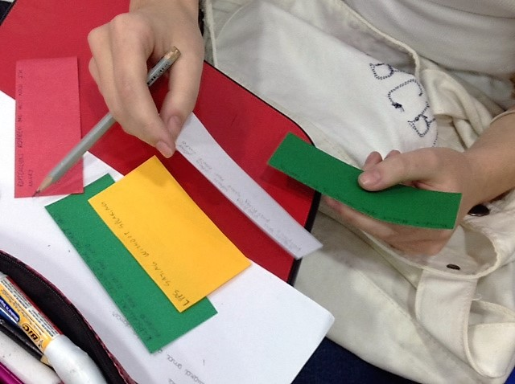
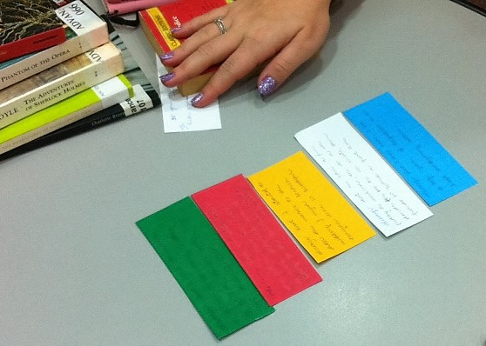
10. Write poems with the five lines. You can add or remove a word from each line, but not change the sentences completely.
11. Read the poems aloud.

Slide 11
Examples
They fell in love with each other
While listening to a sad love song.
Suddenly, their lips were touching…
They found true love – a perfect connection!
However, as the days passed by
They started to feel awkward,
And realized they were actually
The characters of that song.
Isabella
Wedding disasters are extremely common in his life
Generally because he feels very sleepy at them,
Thinks they are for uninteresting people.
However, the song in this particular wedding was good.
It got him thinking:
‘Emotions are better when you listen to music you like.’
Suddenly,
‘Twas a good wedding,
‘Twas a good night.
Leonardo

Slide 12
Books:
Frankenstein, Mary Shelley
The Phantom of the Opera, Gaston Leroux
The Adventures of Sherlock Holmes, Sir Arthur Conan Doyle
The Adventures of Huckleberry Finn, Mark Twain
Jayne Eyre, Charlotte Bronte
Pride and Prejudice, Jane Austen

Slide 13
Activity 2: Poem Writing
Under the spell of verse, alliteration, rhyming and rhythm, musicians have long been enchanted by the masterminds behind poetry. Whether it be the mention of a poet’s name, appropriation of lines from their works, or some other tribute, literary references pervade many bands’ lyrics. And it is always inspiring to hear how one artist’s work can open the doors to creativity across other art forms.

Slide 14
Listen to these songs and write a line of what you feel / remember.
a) https://www.youtube.com/watch?v=6on2p-ViSTc
b) https://www.youtube.com/watch?v=ey09zzMFg5A
c) https://www.youtube.com/watch?v=eAbgJc0agU4
d) https://www.youtube.com/watch?v=IOMwu6OoGo4
e) https://www.youtube.com/watch?v=zLRj-T6-Nw4

Slide 15
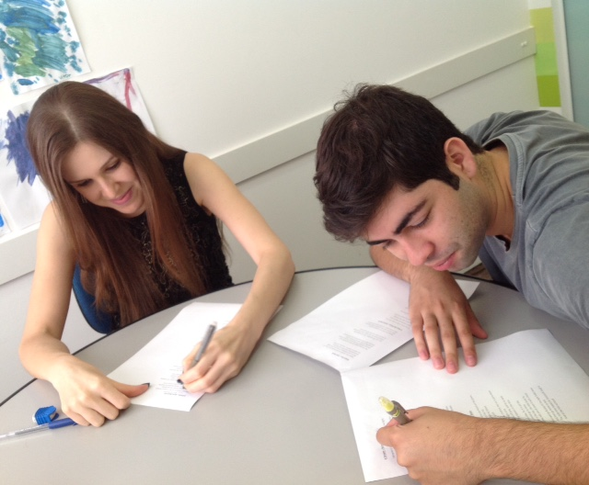
2. Read the poems and match them to the songs according to their melodies / sounds.
3. Choose one line from each poem.
4. Write another poem using the lines you wrote and the lines you selected from the poems.
Dying is fine (Ra Ra Riot) – Dying is fine (e.e.cummings)
Apres Moi (Regina Pasternack) – A Dream (Boris Pasternak)
Blake’s View (M. Ward) – The Nurse’s Song (William Blake)
Cemetery Gates (The Smiths) – Bright Star (John Keats)
I love my Jean (Camera Obscura) – A Red, Red Rose (Robert Burns)

Slide 16
Examples
Dying is fine. But death? Oh, baby, I wouldn’t like.
I want to go out and run on a sunny day again.
But time went on, I grew old and deaf.
I was sitting on a chair, drinking, thinking about life.
But I had to come home, the sun has gone down.
I am calm, just chilling out.
Awake for ever in a sweet unrest,
Feeling depressive,
Sleeping…
Til a’ the seas gang dry.
- Pedro Pincerno
Perfectly natural, perfectly
Putting
It mildly lively like in high school times.
But time went on…
When thinking about how life goes on, I grew old and deaf.
In a cold afternoon, up in the sky, a little bird flies
To feel for ever its soft fall and swell
Though it were then thousand miles…
- Ana Claudia Paffaro

Slide 17
If I were to teach a child the beauty of music, I wouldn’t start with a musical score. We would listen together to the most pleasant melodies and I would tell them about the instruments which make the music. Then, amazed with the beauty of music, they themselves would ask me to teach them the mystery of those little black dots written on five lines. Because these little black dots are only tools for the musical production. The experience of beauty must come first.
- Rubem Alves

Slide 18
Thank you!
Email: malusciamarelli@gmail.com
Website: www.malusciamarelli.weebly.com
The C Group: www.thecreativitygroup.weebly.com

