Slide 1
The Others: Stereotypes and Cultural Representations in English Literature
Nella De La Fuente
July, 2016

Slide 3
Who are the others?

Slide 4
Western
American
South American
Brazilian

Slide 5
Alterity
Alterity [all-ter-eh-tee] is a philosophical term meaning ‘otherness,’ strictly being in the sense of the other of two. In the phenomenological tradition it is usually understood as the entity in contrast to which an identity is constructed, and it implies the ability to distinguish between self and not-self, and consequently to assume the existence of an alternative viewpoint.
https://www.google.com.pe/search?q=alterity&source=lnms&tbm=isch&sa=X&ved=0ahUKEwjfl9adht_NAhXLFx4KHZtQB9kQ_AUICCgB&biw=1280&bih=649#imgrc=7eyCt0afIYgJTM%3A

Slide 6
An experience…
Make up a list of things you consider typical of your country. Include different categories such as food, clothes, drink, entertainment, places and famous people.
Make a list of adjectives to describe what you consider the typical personality traits of a person of your nationality.
Compare your list with other people in your class and discuss these questions.
What things do your lists have in common? What things are different?
Do you think people living in different parts of your country would have lists similar to yours? Why (not)?
Do you think people belonging do different age groups or with different social and financial situations would have lists similar to yours? Why (not)?

Slide 7
A chicken…

Slide 8
… is a chicken is a chicken…

Slide 9
Finding others…
Happens in Literature, happens in real life

Slide 10
Creole
Coloured
Gypsy

Slide 11
Bertha Mason
Jane Eyre
Wide Sargasso Sea
1847, Charlotte Brontë
Bertha is a Creole, the daughter of a white European settler in the West Indies
Depicted as ‘clothed hyena’, a ‘figure’, described using the neutral pronoun ‘it’ (ch. 26)
described as a ‘goblin’ and a ‘vampire’ who threatens to ‘drain [Mason’s] heart’ (ch. 20)
uneasy and even threatening presence
1966, Jean Rhys
Renamed. Formerly Antoinette Cosway
Rochester’s decision to call Antoinette ‘Bertha’ is just one of the acts of violence, both actual and metaphorical
rejected by Rochester and treated as a ‘white cockroach’ by her family’s black servants.
See more at: http://www.bl.uk/romantics-and-victorians/articles/the-figure-of-bertha-mason#sthash.te6eW4AX.dpuf

Slide 12
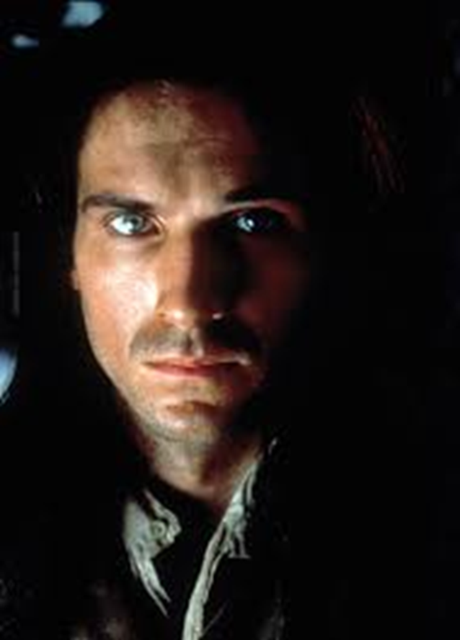
Heathcliff…

Slide 13
Heathcliff…
characterized as devilish and cruelly referred to as "it" in the Earnshaw household. His language is "gibberish" and his dark otherness provokes the labels "gipsy," "wicked boy," "villain," and "imp of Satan."
During a three-year absence, Heathcliff is physically transformed. No longer a beaten-down street kid, he has become, as Nelly puts it: ... a tall, athletic, well-formed man; beside whom my master [Edgar] seemed quite slender and youth-like. His upright carriage suggested the idea of his having been in the army. His countenance was much older in expression and decision of feature than Mr. Linton's; it looked intelligent, and retained no marks of former degradation. A half-civilised ferocity lurked yet in the depressed brows and eyes full of black fire, but it was subdued […] (10.53) By the time Lockwood meets him, Heathcliff is still dark and swarthy, of course, but now embodies the social status that he has gained over the last twenty-five years. Lockwood notes: Mr. Heathcliff forms a singular contrast to his abode and style of living. He is a dark-skinned gipsy in aspect, in dress and manners a gentleman: that is, as much a gentleman as many a country squire [...] (1.15)

Slide 14
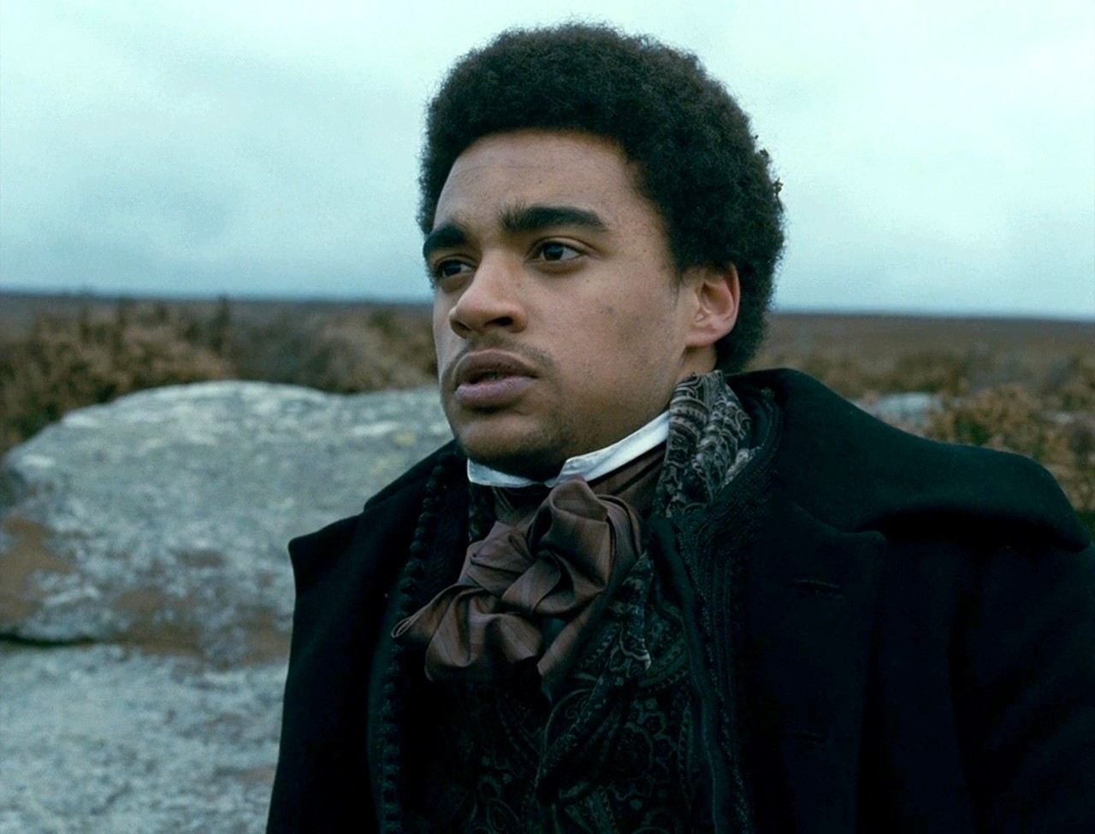
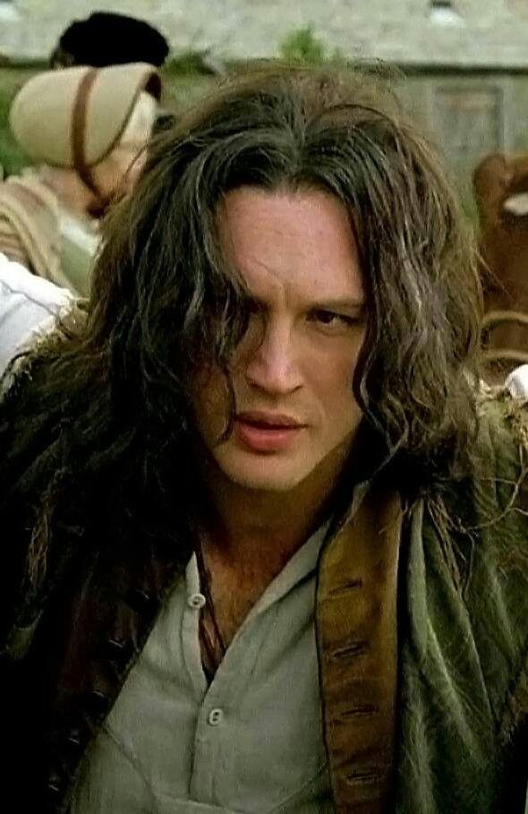
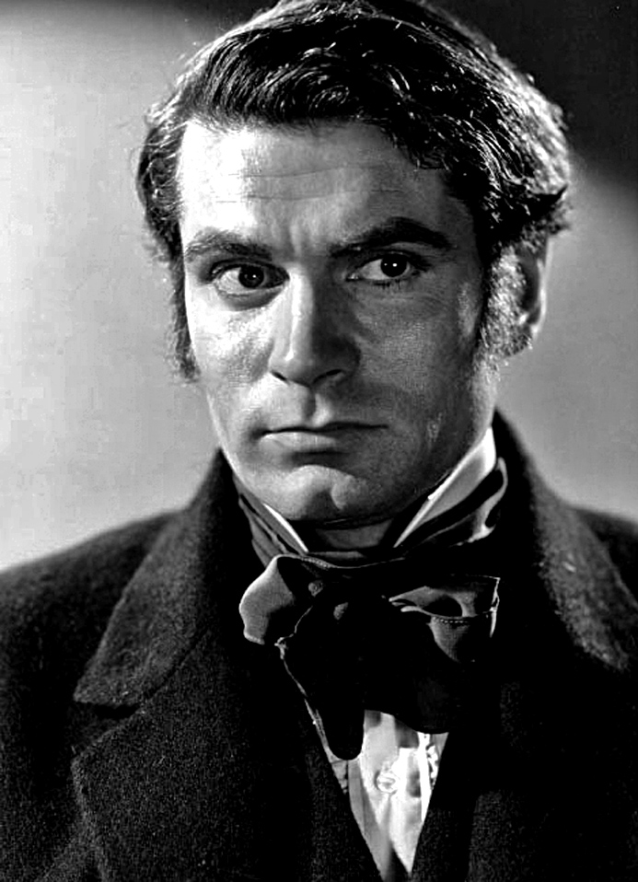
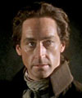
Ralph Fiennes
Tom Hardy
Lawrence Olivier
James Howson
Solomon Glave
Robert Cavanah
Keith Michell
Kieron Moore
Rex Downing

Slide 15
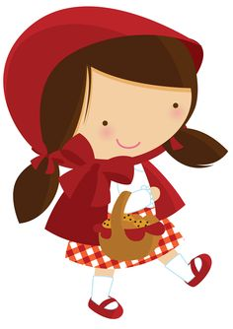
Little Red Riding Hood
“…a dear little girl who was loved by everyone who looked at her, but most of all by her grandmother…”

Slide 16
Roald Dahl’s Little Red Riding Hood
https://www.youtube.com/watch?v=Y3uVQIhSYfY

Slide 17
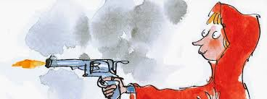
Roald Dahl’s Little Red Riding Hood

Slide 18
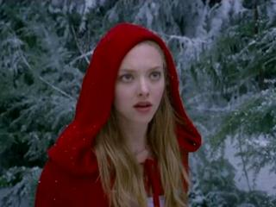
Still a girl in a red riding hood…

Slide 19
Stereotypes…
Where do they come from?
Where do they lead?
?
?

Slide 20
The Others: Stereotypes and Cultural Representations in English Literature Thank you!
Nella.delafuente@gmail.com
July, 2016

